Slide 1



Role of Language Models in ASR
AI4Bharat Speech Team

Slide 2
Why do we need LM?
Speech = Acoustic + Language
How much of Language Characteristics is captured by Acoustic Models?
Example #1:
GT: आज सुनेहरा अवसर है
Output: आज सुनहरा अवसर है
Example #2:
GT: आज सुनेहरा अवसर है
Output: आज सुनेहरा अफसर है
Example #3:
GT: आज सुनेहरा अवसर है
Output: आज सुनेहरा अवसर हैं
Spelling Errors!
Homophones!
Inflections!

Slide 3


What LM actually computes?
Probability (Likelihood) of a sentence:
We generally limit it to N-1 previous words!
Example: Bigram Language Model
text = “<start> आज सुनेहरा अवसर है <end>”
P(text) = P(<start> | आज ) * P( आज | सुनेहरा ) * P(सुनेहरा | अवसर ) * P( अवसर | है ) * P( है | <end>)
N-gram LM!

Slide 4
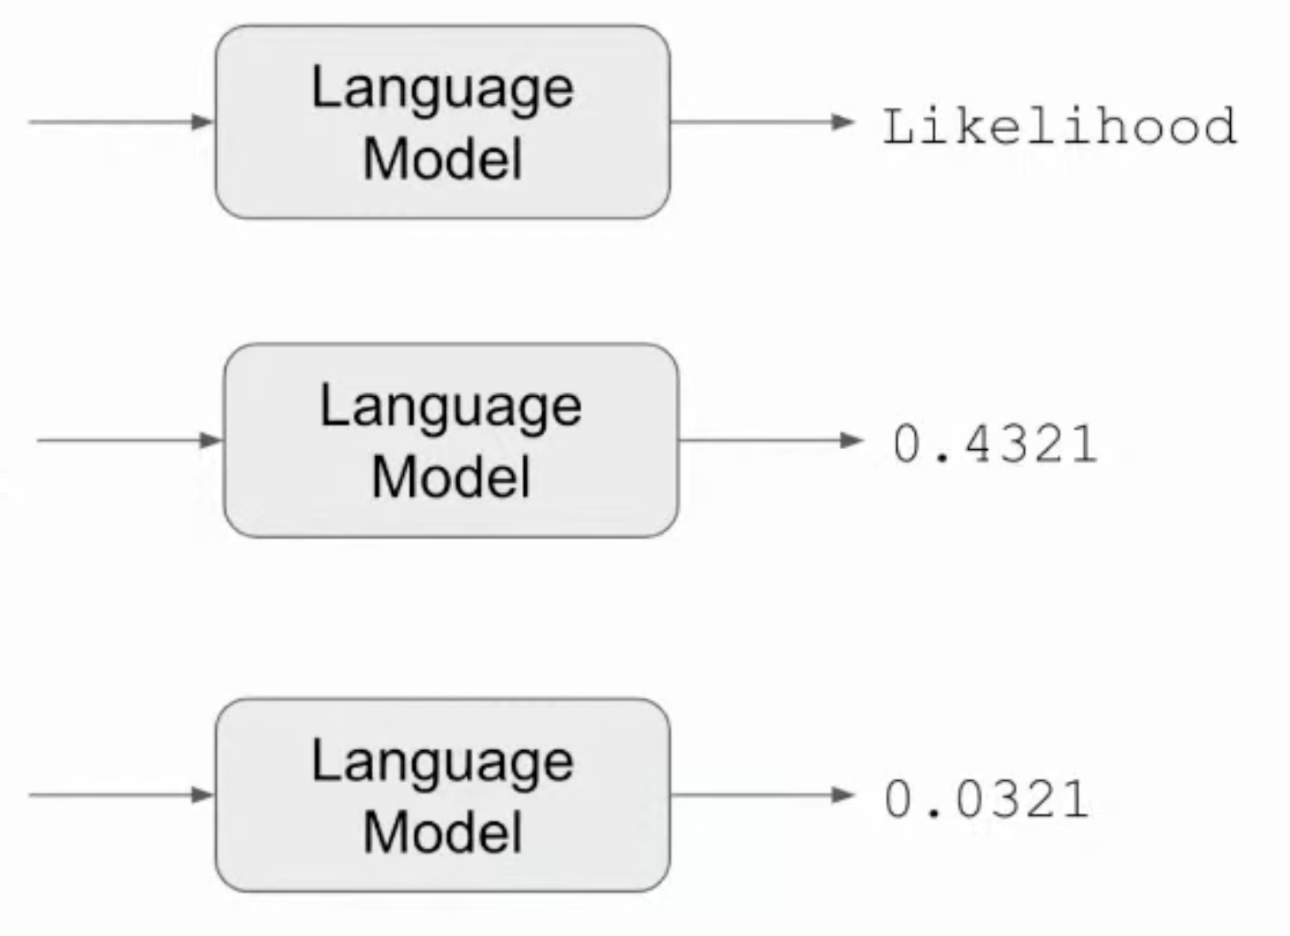
What LM actually computes?
Proposed Text
आज सुनेहरा अवसर है
सुनेहरा आज है अवसर

Slide 5
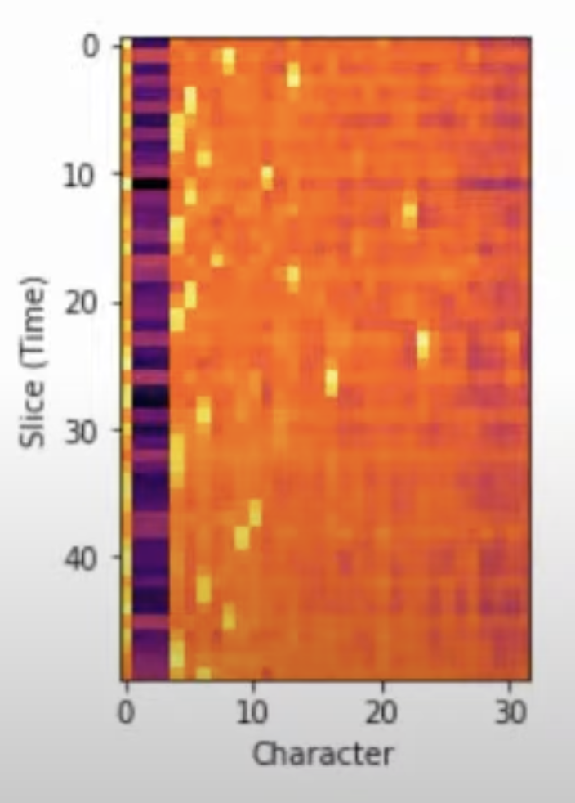
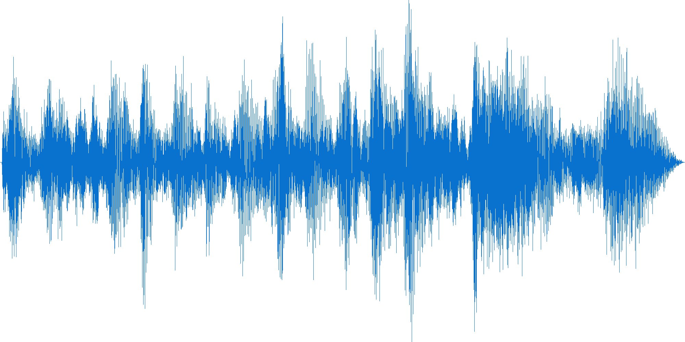
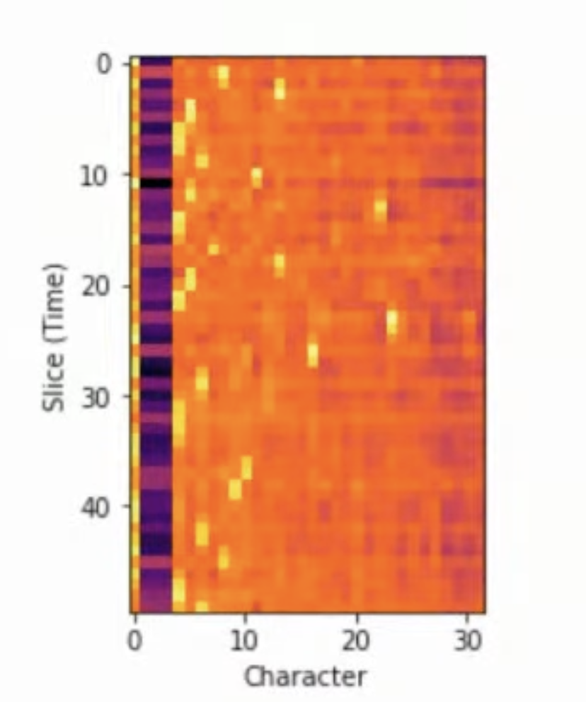
Where do we fit LM?
Typical ASR pipeline:
Preprocessing
Acoustic Model
Wav
Audio
Features
Logits
CTC Logit Matrix:
- Leads to softmax output which predicts character probabilities for each timeframe.
- Output Length is NOT proportional to Text Length, but to Audio Length.

Slide 6
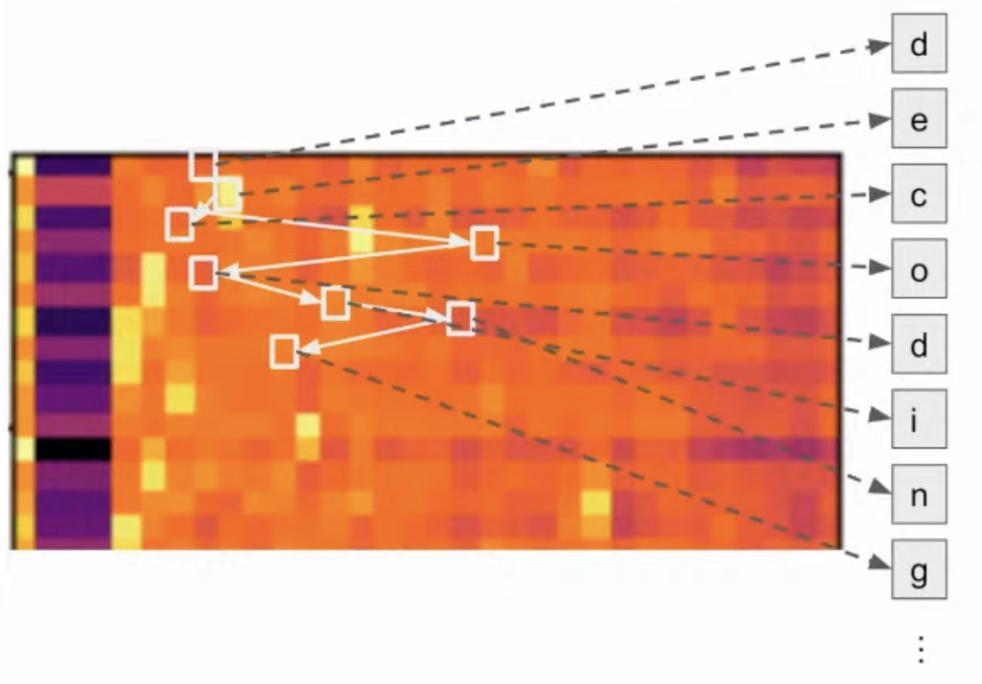
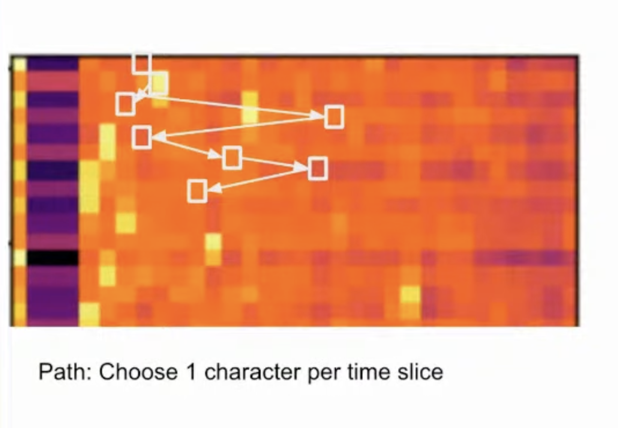
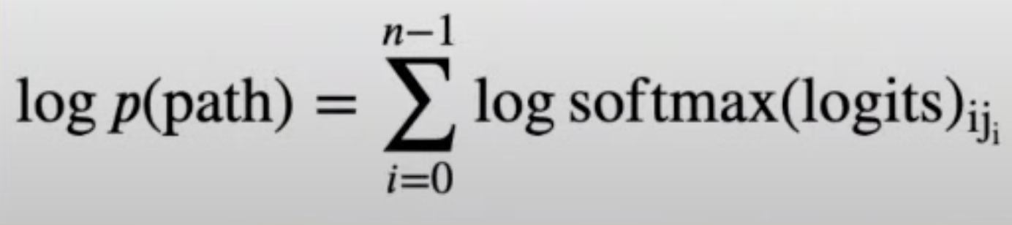
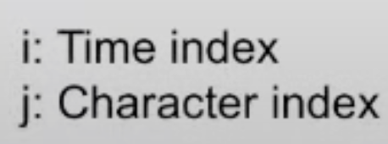
Logits Decoding - Concept
Decoder evaluates Paths through the logit matrix:
Greedy Solution vs Exact Solution

Slide 7

Logits Decoding – with LM
Incorporate LM scores with logits while decoding
Exact/True Solution
Score every possible path through logit matrix with addition of LM
Combine scores of equivalent paths
Take the highest-scoring text
Extremely Slow!

Slide 8
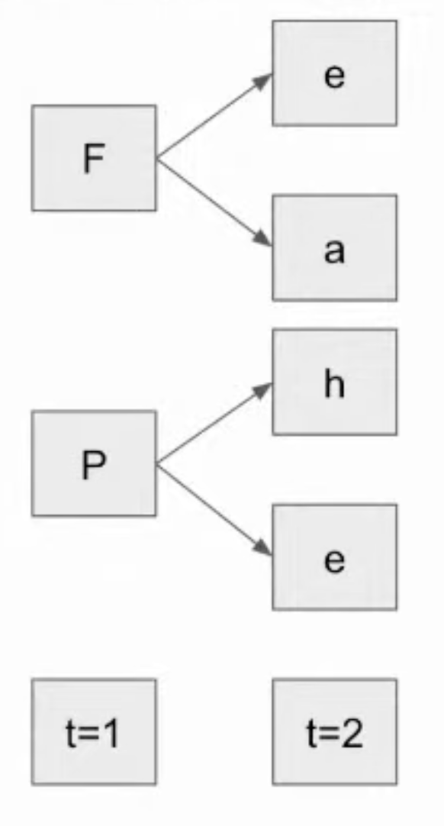
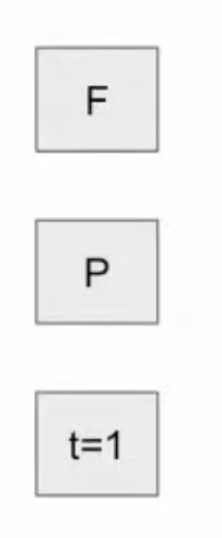
Beam Search: Fast Approximate Solution
Step 1: Select the N best characters from the first time slice

Slide 9
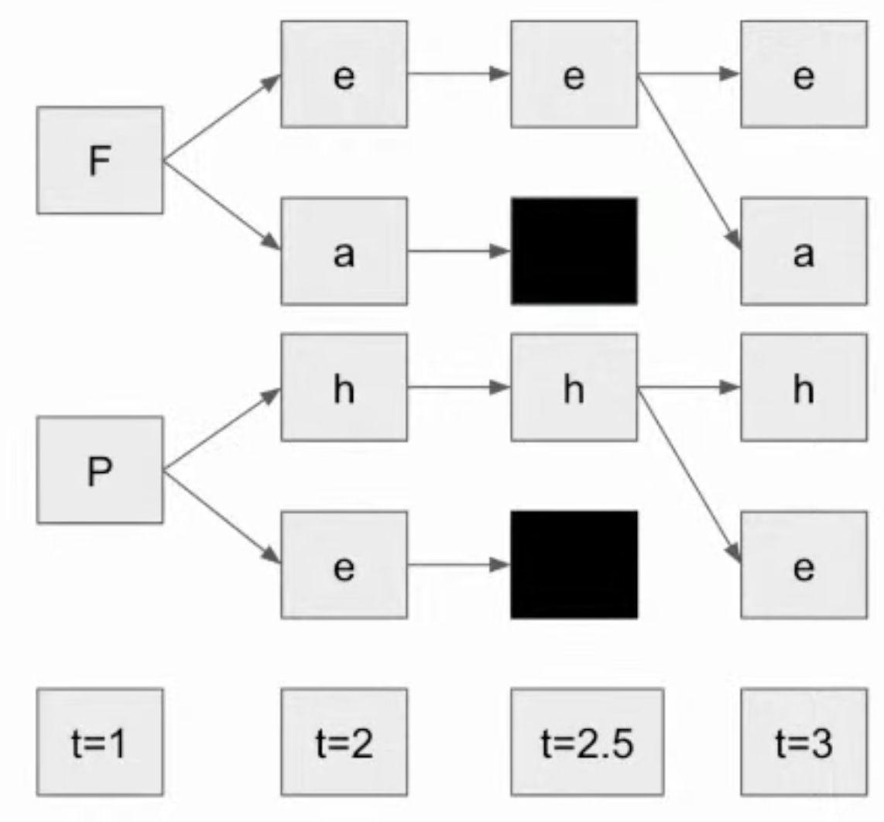
Beam Search: Fast Approximate Solution
Step 2.5: Rescore text outputs with the language model.
2.5: PRUNE on the basis of beam size

Slide 10
Beam Search: Fast Approximate Solution
Step 3: Continue by adding 3rd timestep, choosing the N best …
If Beam-size = 1 => Greedy Decoding; if Beam-size = inf => Exact Soln

Slide 11
Tools of the Trade
Pyctcdecode
Support for Hotwords 🔥
Easy to Setup & Experiment
Direct Support for Huggingface Speech Models, NeMo Speech Models, etc.
Comparively Slower because of Python Implementation 👎
No support for Neural Language Models 😿
Flashlight
Supports decoding with Neural Language Model 🚀
Extremely Fast Decoding ✨
More Configurations Options
Rapidly Evolving Library with limited backwards compatibility
Official Documentation Only supports Fairseq

Slide 12
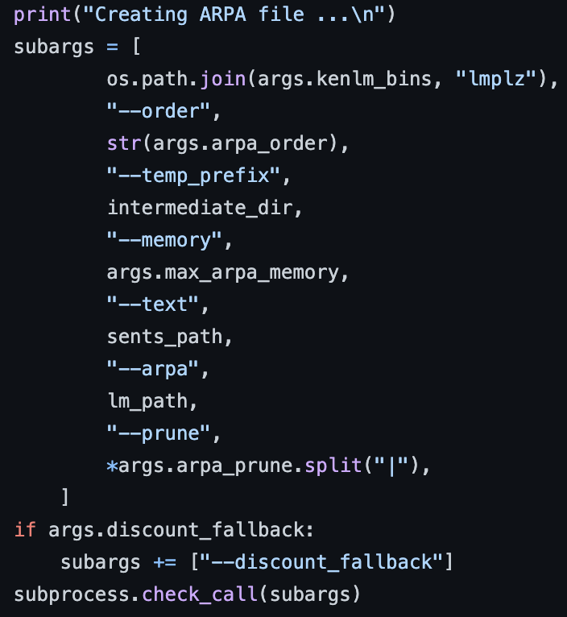
ASR+LM in action
Training Kenlm
Step 1: Creating ARPA file

Slide 13
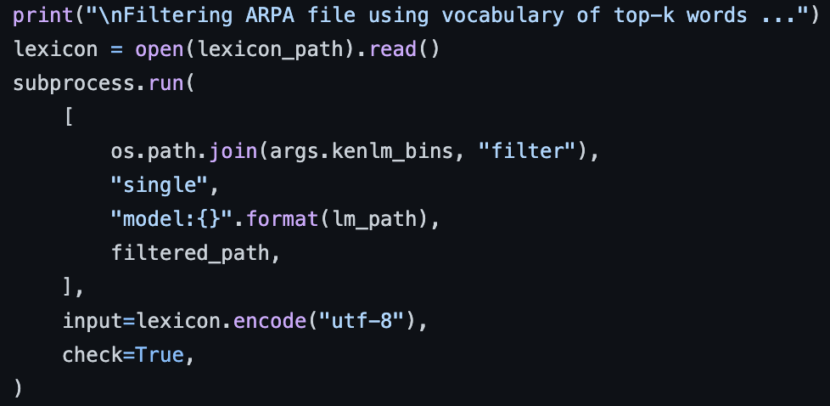
ASR+LM in action
Training Kenlm
Step 2: Filtering from Lexicon

Slide 14
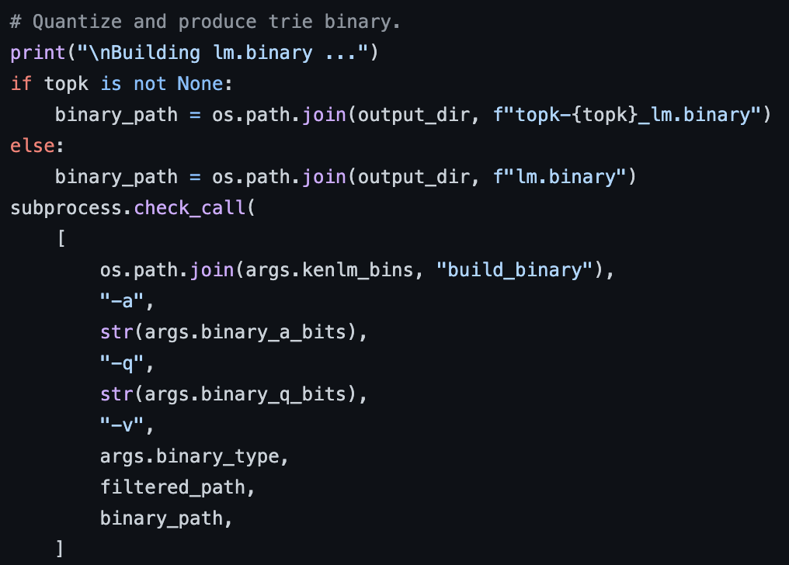
ASR+LM in action
Training Kenlm
Step 3: Quantizing to 8 bit

Slide 15
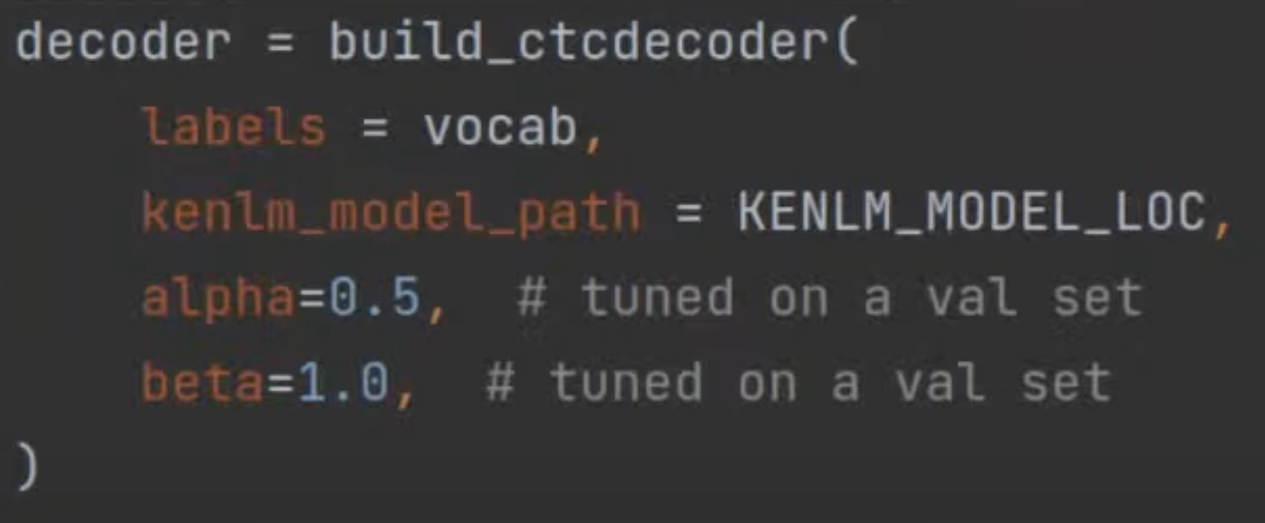

ASR+LM in action
Decoding with pyctcdecode
Build CTC Decoder
Decode logits from Acoustic Model

Slide 16
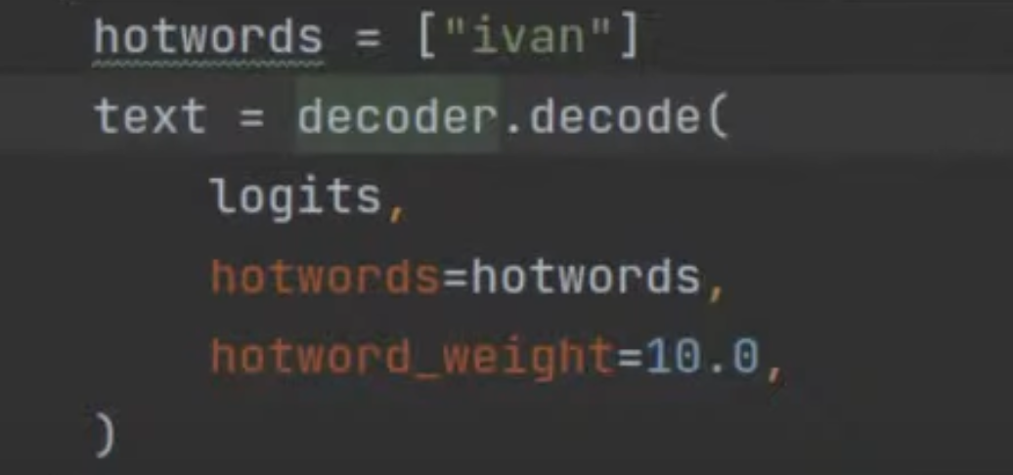
ASR+LM in action
Decoding with pyctcdecode
Decoding with hotwords

Slide 17
Some Numbers from IndicWav2Vec
Lexicon Size: 200,000
“n” in N-grams: 6 grams
Avg. decrease in WER: 28% reduction (21.6 to 15.6)
Model | gu | ta | te | gu | hi | mr | or | ta | te | bn | ne
IndicW2V | 20.5 | 22.1 | 22.9 | 26.2 | 16.0 | 19.3 | 25.6 | 27.3 | 29.3 | 16.6 | 11.9
IndicW2V+LM | 11.7 | 13.6 | 11.0 | 17.2 | 14.7 | 13.8 | 17.2 | 25.0 | 20.5 | 13.6 | 13.6
WER Numbers per language

Slide 18
Future Scope
Decoding with Neural Language Models
Better integration of Language Models
Deep Fusion of LM External LM is fused directly into the ASR model by combining their hidden states, resulting in a single model with tight integration.
End-to-end Training with LM Can we pass the gradients obtained after decoding with LM?

Slide 19

प्रश्नकाल?

Slide 20
Thank You https://ai4bharat.iitm.ac.in/

